Slide 1



Deep Learning Time Series Prediction Strategies for Efficiently Emulating Noah Land Surface Model Soil Moisture Dynamics
Mitchell Dodson^{1,2}
Dr. Chris Hain¹
Dr. Sundar Christopher²
Dr. Sean Freeman²
(1.) NASA SPoRT (MSFC)
(2.) University of Alabama in Huntsville

Slide 2
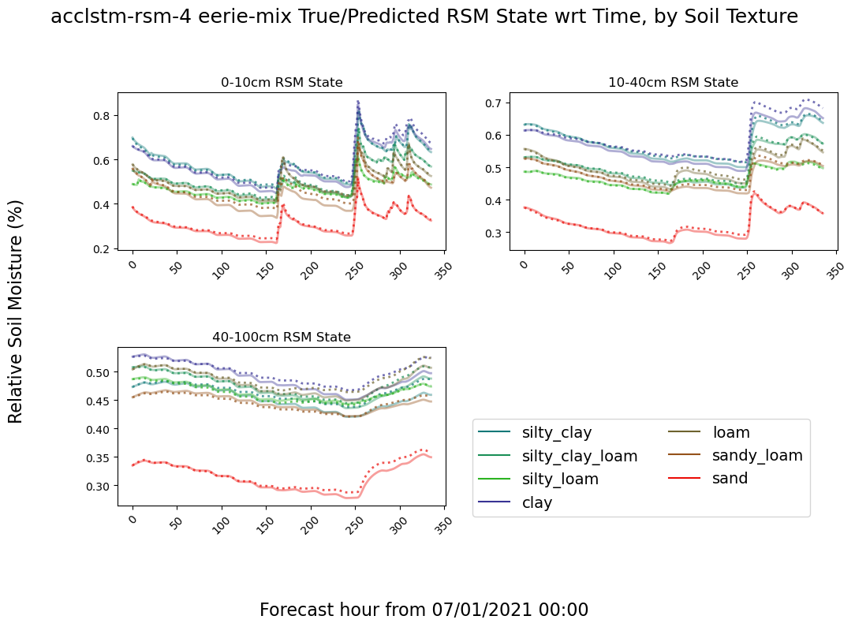
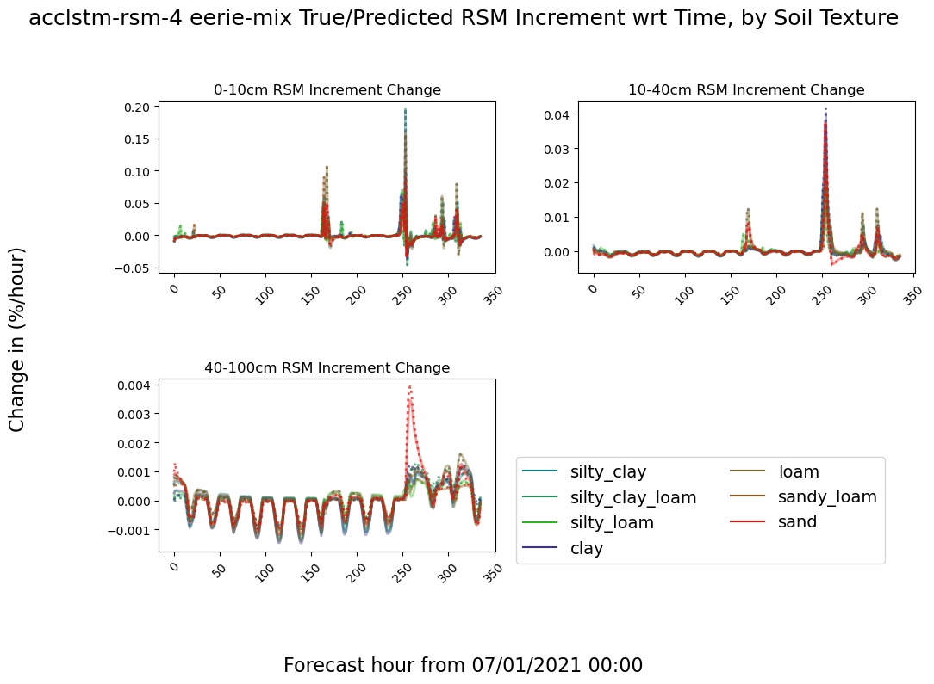
Overview and Goal
Example of Noah-LSM and Prediction Dynamics
I am developing a software system to train and evaluate time series regression neural networks with the goal of emulating the soil moisture dynamics of the Noah-2.8 Land Surface Model at hourly resolution, out to 2 weeks.
Why Data-driven Model Emulators?
Shorter execution time
Simpler computing environment
Which enables...
Generating quick ensemble estimates
End-user applications for evaluating custom forecast hypotheticals.
Soil Moisture State Evolution Over 2 Weeks,
separated by soil texture
Corresponding Soil Moisture Hourly Time Derivative
Henceforth the “increment”

Slide 3
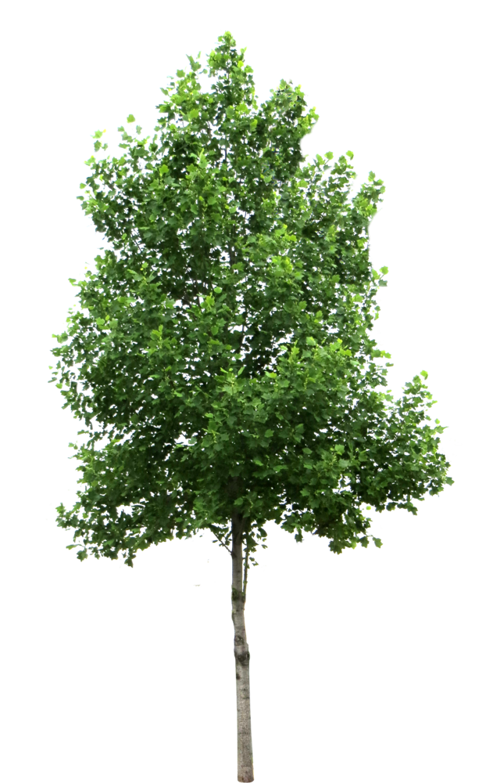
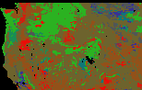
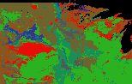


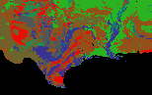

NLDAS-2/Noah-LSM background
Schematic of Noah-LSM feedbacks & processes
canopy
interception
precipitation,
condensation
transpiration
canopy evaporation
Noah-LSM is a 1D model with 4 discrete depth layers of thicknesses 10cm, 30cm, 60cm, and 100cm (only first 3 considered here).
Outputs on ⅛º (~14km) grid over CONUS
Most NLDAS-2 forcings are are derived from NARR, precip from CPC/PRISM, and insolation aided by satellite-derived products.
Infiltration
sublimation
snow melt
runoff
direct evaporation
root uptake
vertical moisture flux
sub-surface runoff
Soil texture RGB (sand,silt,clay) and pixel counts per region
Dynamic inputs:
SW/LW Radiation
Wind speed/bearing
Temperature
Mixing ratio
Precipitation
Pressure
Static inputs:
Soil texture component percentages (STATSGO)
Elevation & stdev (USGS)
Vegetation type (UMD classes)
NW: 13,848px
NC: 13,509px
NE: 6,420px
SW: 4,767px
SC: 9,907px
SE: 4,005px

Slide 4
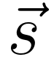
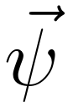

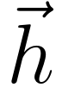
Numerical Modeling: Drawbacks of Discrete Integration
Noah-LSM is a series of explicit representations of coupled differential equations with a variety of parameterizations.
No context maintained other than previous state output.
In order to remain numerically stable when integrated using a locally linear assumption (Crank-Nicholson method), Noah-LSM uses 15 min timesteps, which are aggregated to 1 hour.
Much compute goes to estimating a nonlinear function with linear segments.
0
1
H-1
A
A
A
-1
0
H-2
-1
0
H-2
Sequence-to-sequence prediction schematic
Self-cycling numerical model schematic
0
1
H-1
k
: Current forcing
k
: Land surface state
D
D
D
: Static parameters
: Hidden (latent) state
Hypothesis: deep learning methods can reduce evaluation time of Noah-LSM by (1) emulating the nonlinearities of the data at a coarser time step, (2) maintaining contextual information between time steps, and (3) representing the relationship between initial states, static parameters, atmospheric forcings, and output states in terms of a computationally simple composition of matrix transformations.
k
G
G
G
E
E
E
init
-1
H-2
-W
-2
-1
0
1
H-2
-W
-2
-1

Slide 5
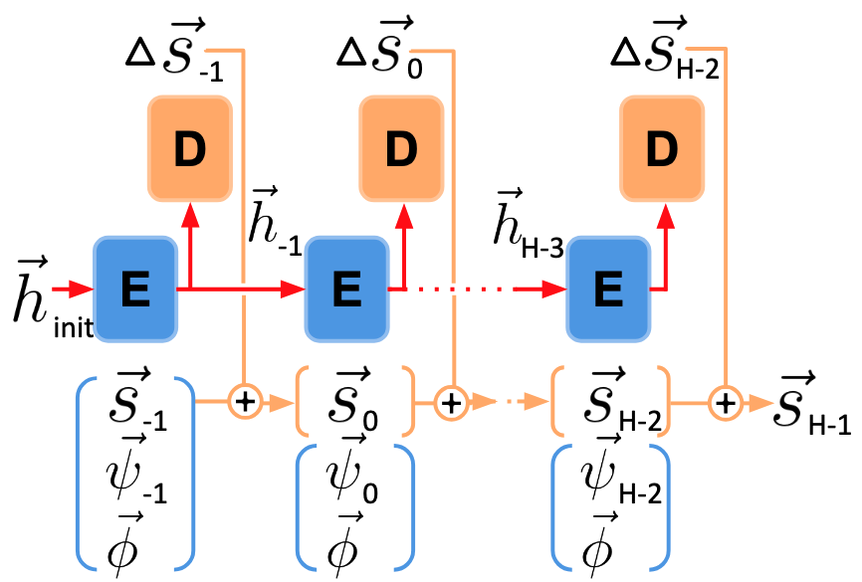
Neural Net Architectures: FNN & RNN
Like the numerical model, the most basic neural net type, the fully-connected neural net (FNN) self-cycles its previous output as a new input at each timestep.
It contains no latent vector passed between steps, which theoretically limits its ability to learn generalizations over time.
0
1
H-1
A
A
A
-1
0
H-2
-1
0
H-2
The recurrent neural network (RNN) addresses this by generating a high-dimensional latent vector at each step, which is decoded to produce the output, and also passed along to the subsequent time step as an additional input.

Slide 6
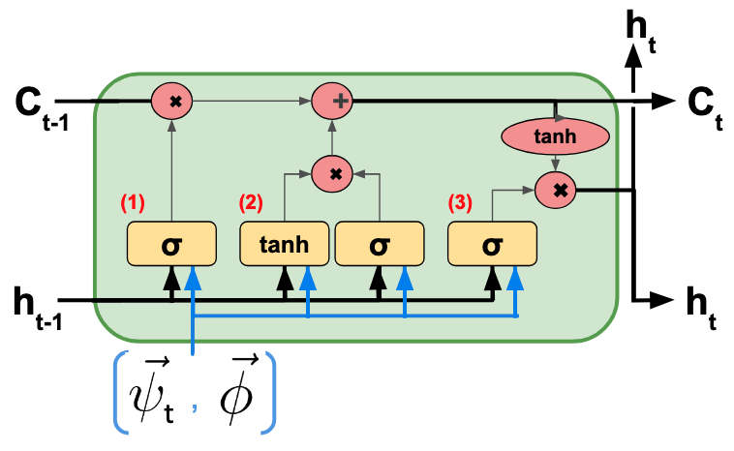
Neural Net Architectures: LSTM, AccRNN, and AccLSTM
RNNs apply full matrix transformations to inputs and latent vectors at each step, which distorts information quickly and makes training less stable.
The long short-term memory (LSTM) architecture addresses this by only linearly modifying the latent vector at each step.
By default, RNN and LSTM don’t cycle their top-layer outputs as inputs to subsequent steps.
Soil saturation is an important component of the governing equations, so I modified the RNN and LSTM to explicitly accumulate it, dubbed AccRNN and AccLSTM.
0
1
H-1
k
: Current forcing
k
: Land surface state
D
D
D
: Static parameters
k
: Hidden (latent) state
G
G
G
E
E
E
init
-1
H-2
-W
-2
-1
0
1
H-2
-W
-2
-1

Slide 7
Evaluation Challenges and Strategies
Data selection:
Training and validating on all data 2012-2018 with 66.7% training split.
Testing on all data 2018-2024
Sample initialization points separated by at least 31 hours to preserve variety.
Independent variables:
Model target (Soil moisture area density or relative soil moisture)
Model type (FNN, AccRNN, AccLSTM)
Loss function parameters
Number of layers and weights per layer
Hyperparameters (activation function, batch normalization, dropout, etc).
Effective evaluation is difficult because:
Model configuration has a large number of independent variables
Dynamics depend strongly on relatively rare events like precipitation, runoff, snow melt.
Static parameters like vegetation and soil texture have a significant and discrete influence on temporal dynamics.
Characterizing performance in terms of meteorological context since input variables are highly auto-correlated and nonlinear.

Slide 8
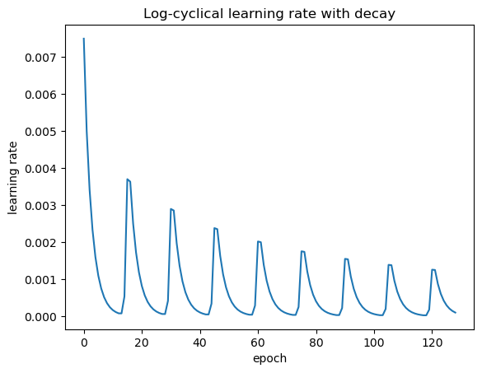
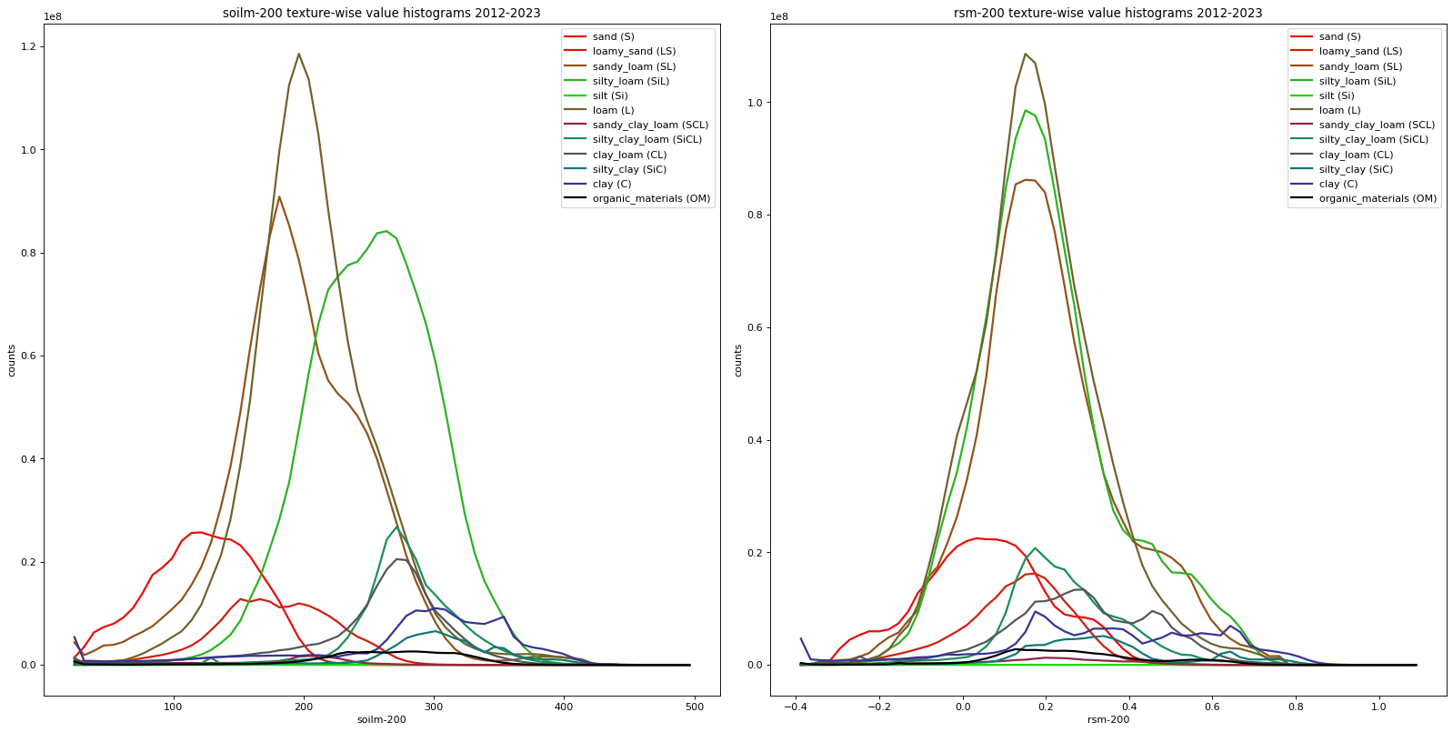
Neural Net Training Methodology
Log-cyclical learning rate with decay
Loss function changes:
Separate state and increment norming
Bias loss proportional to change magnitude
Optionally ignore constant targets (snow)
Log-decreasing cyclical learning rate
Loss balanced between increment change error and accumulated state error with user-selected ratio.
2012-2018 soil state histograms per soil texture
Left: area density (kg/m²).
Right: relative soil moisture (%)
Using state magnitude of an output was very unstable, so models always predict the increment change in state.
Predicting relative soil moisture (RSM), which normalizes water content by hydraulic properties, tends to improve consistency between textures since dynamics (thus loss) occupy the same range of values after normalization.

Slide 9
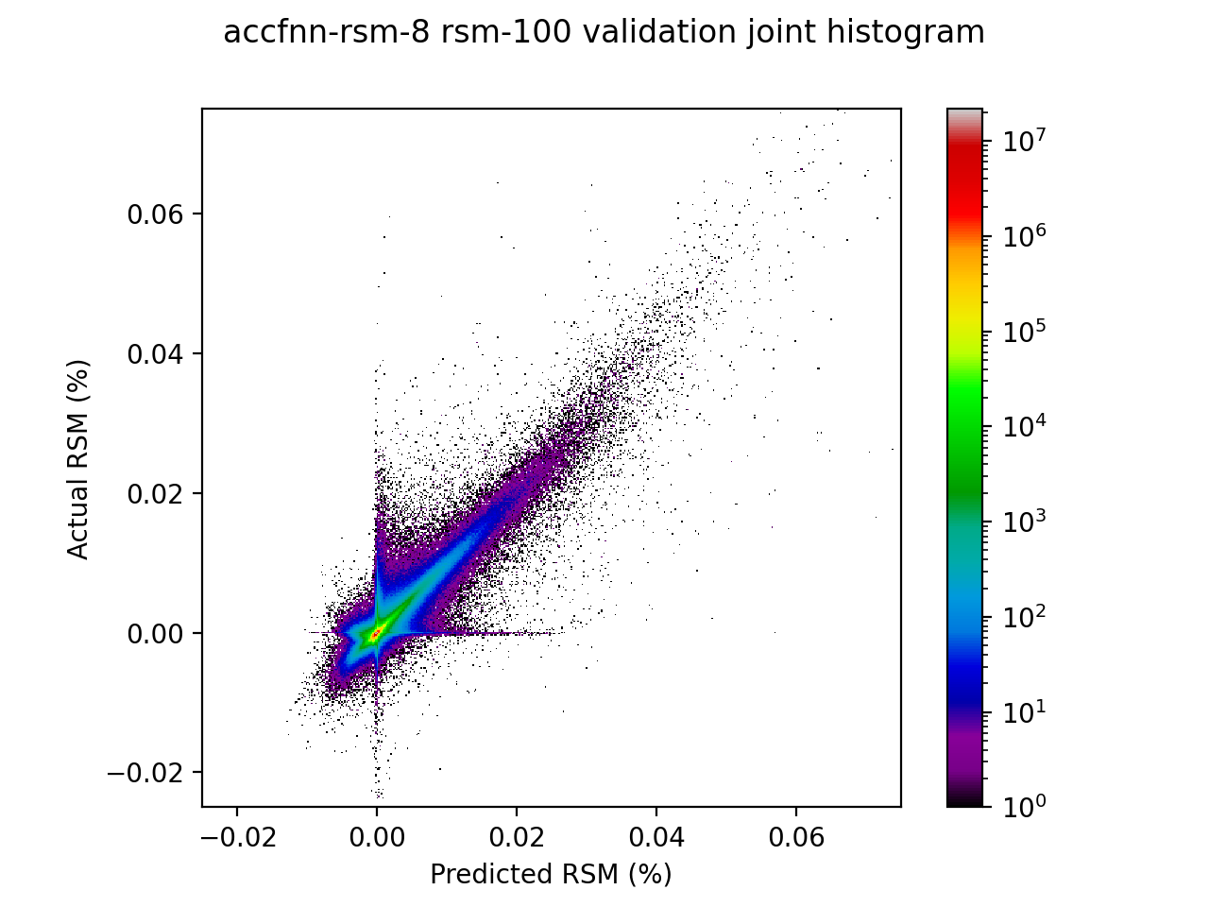
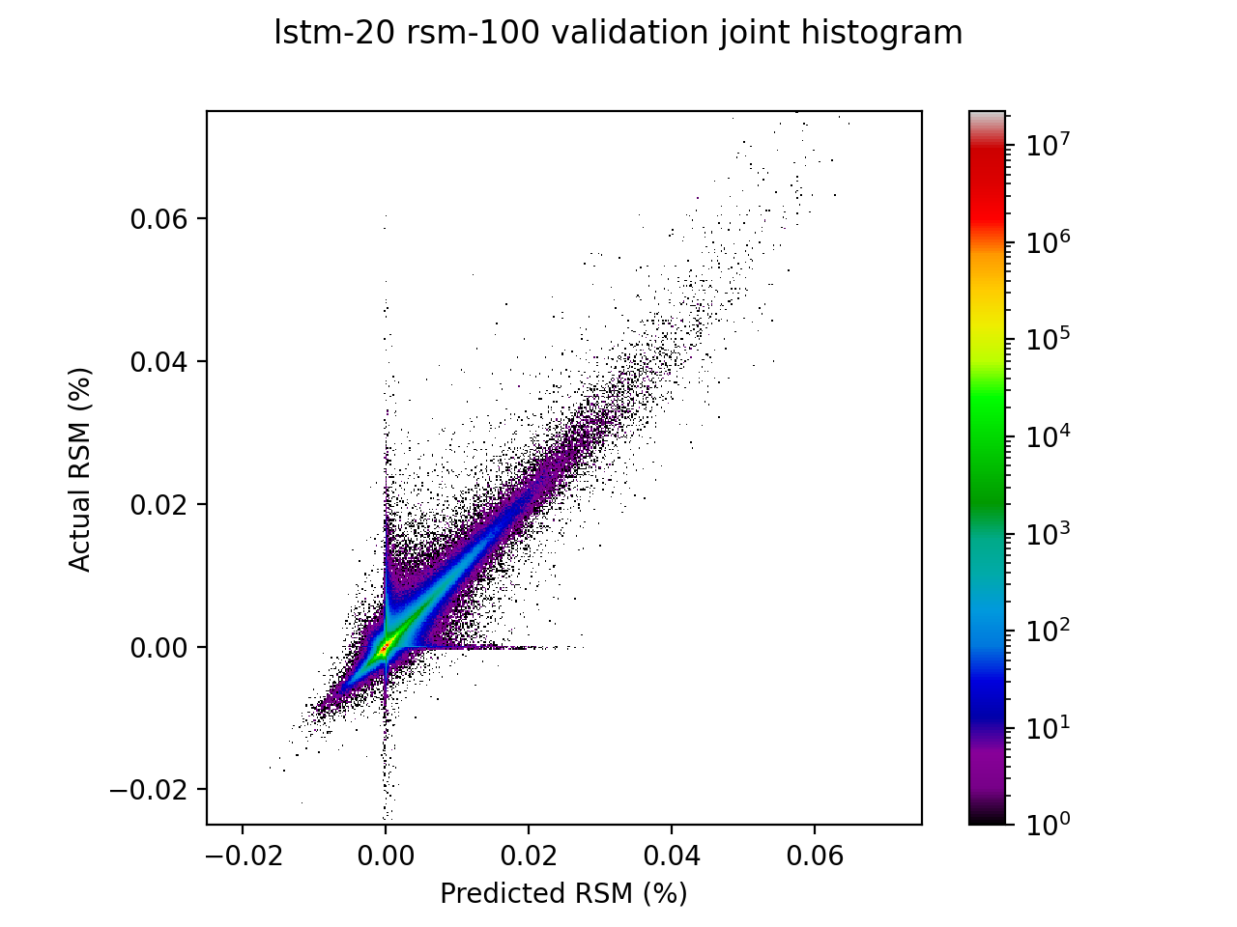
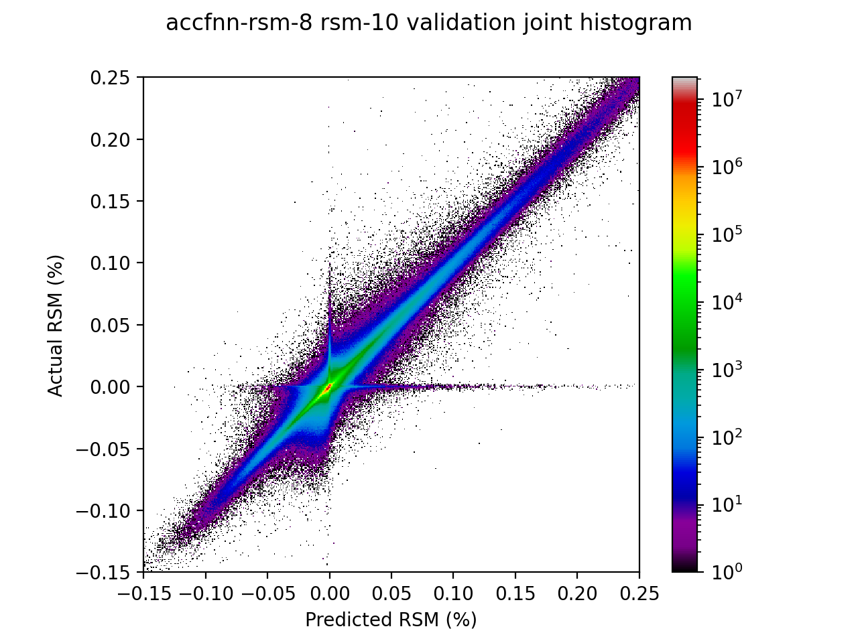
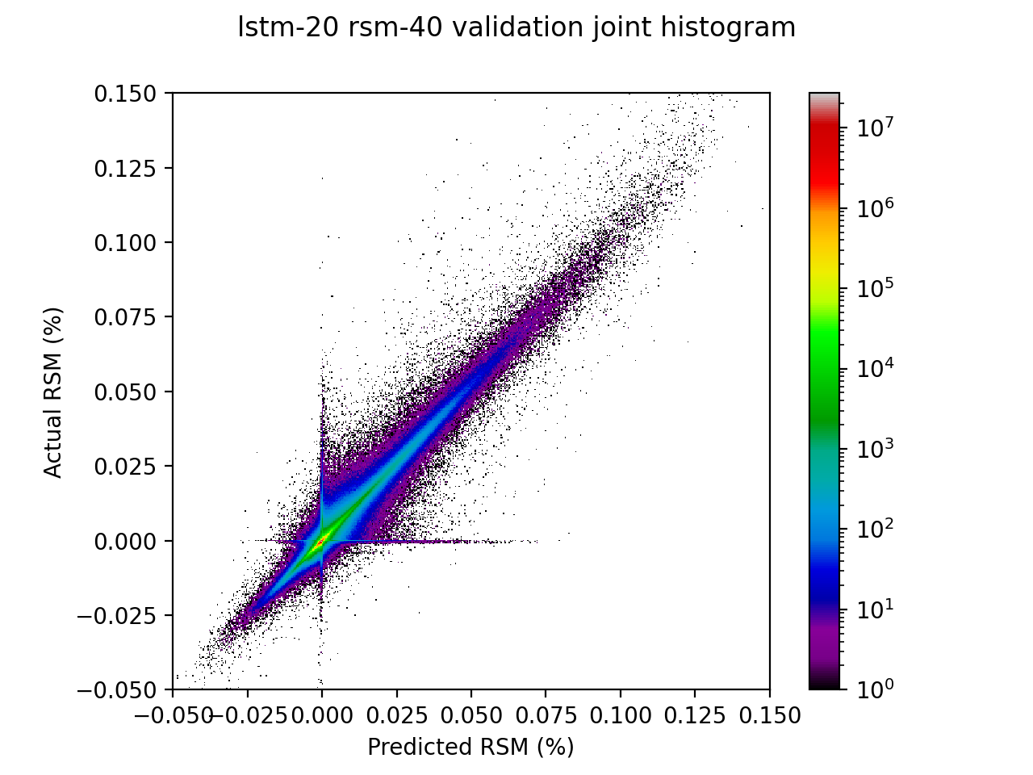
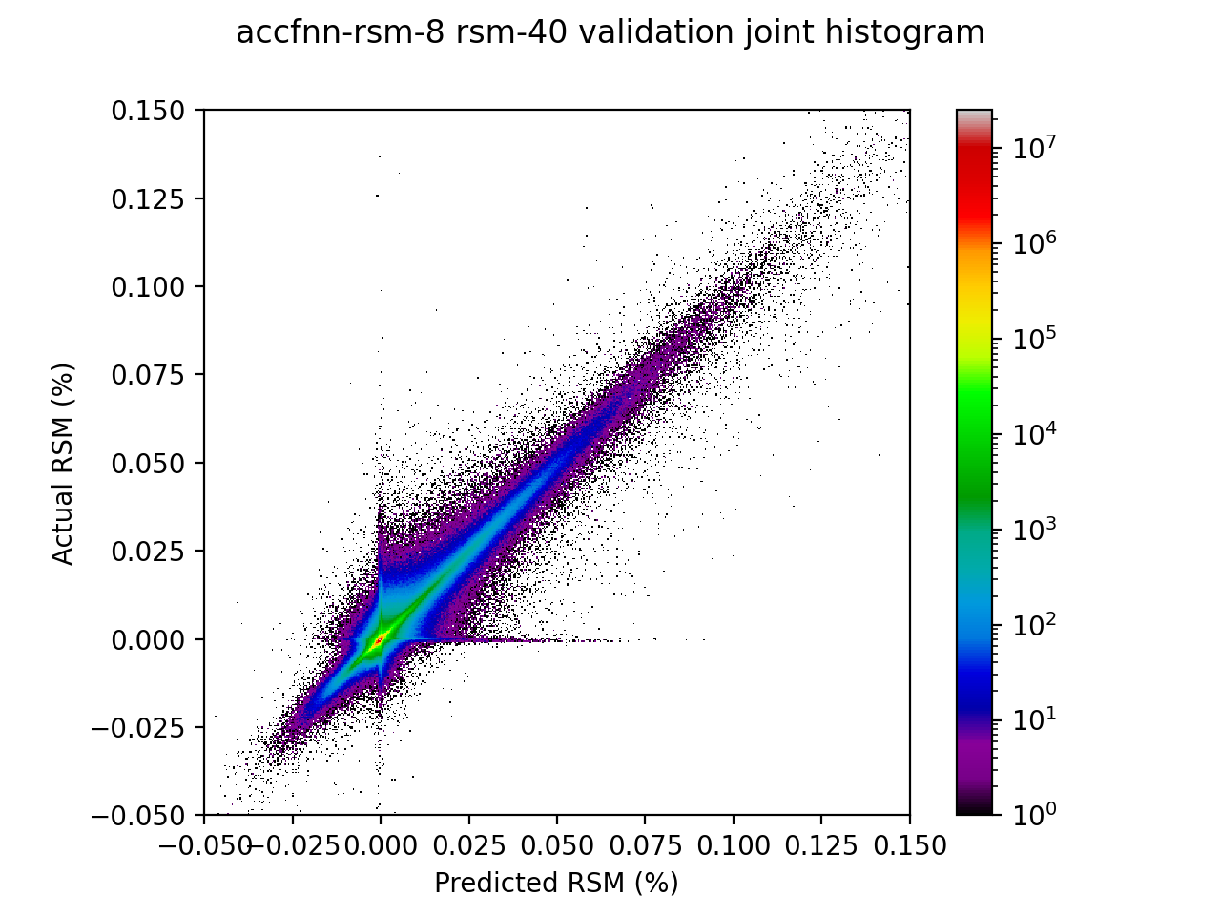
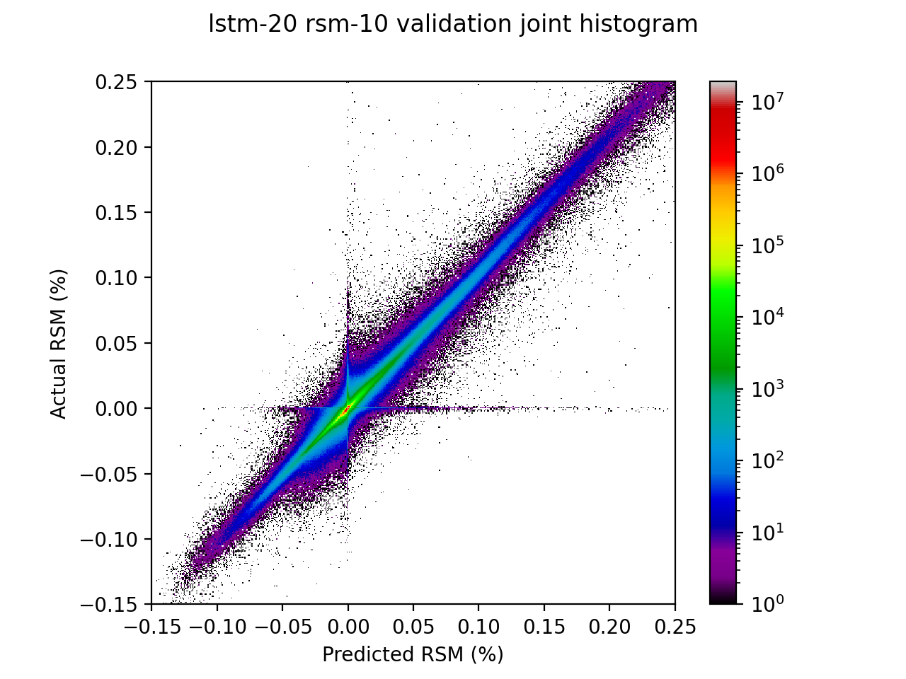
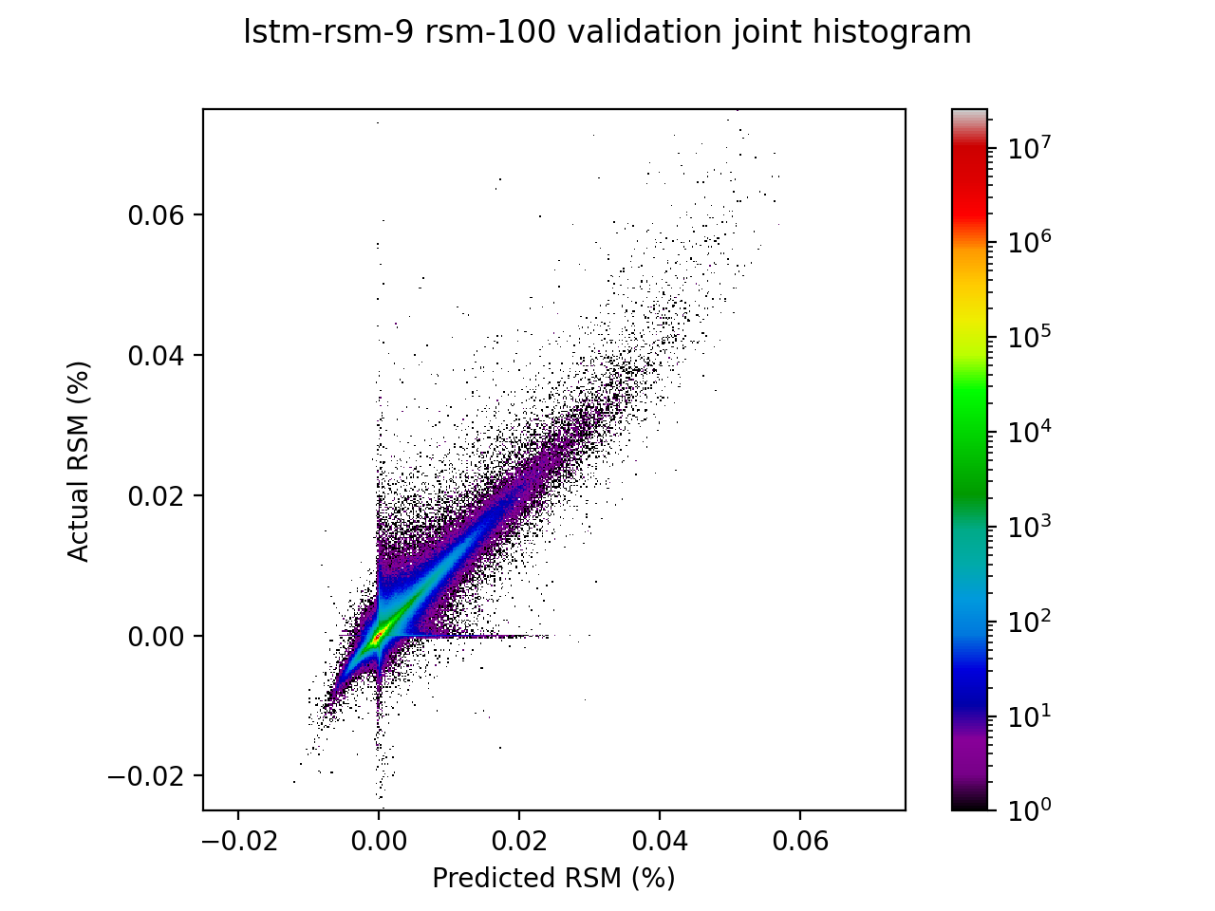
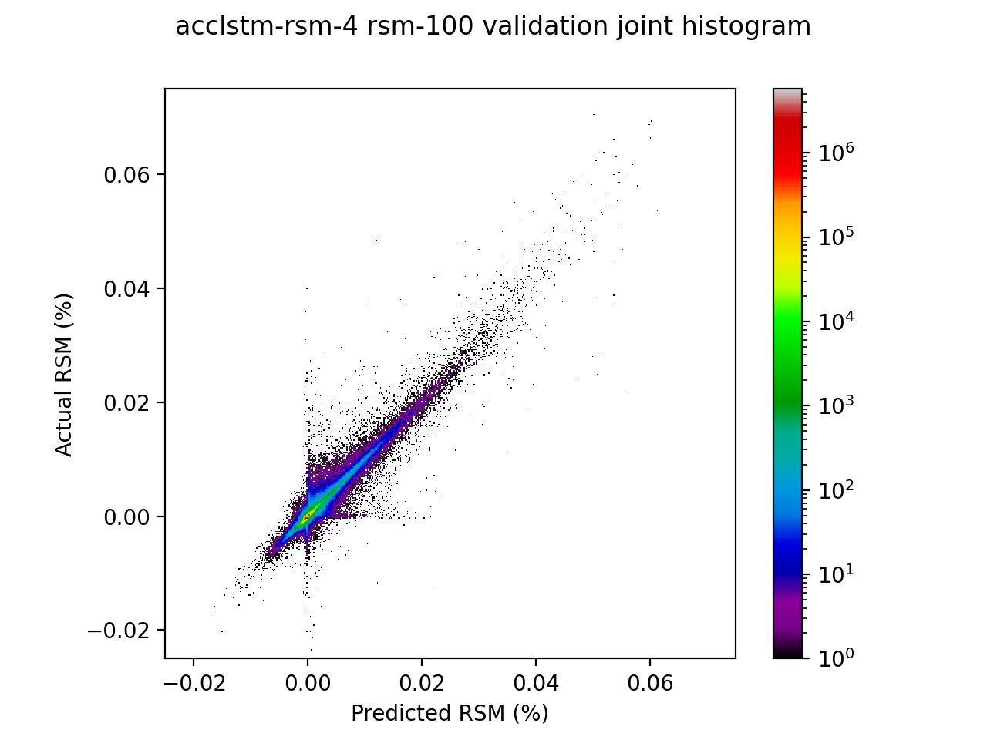
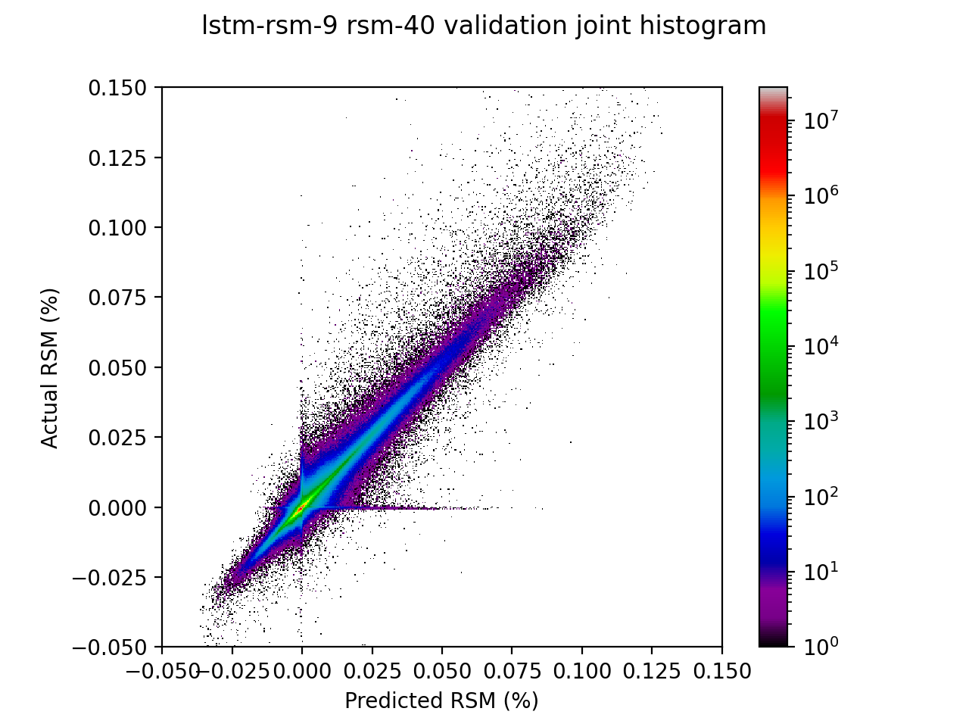
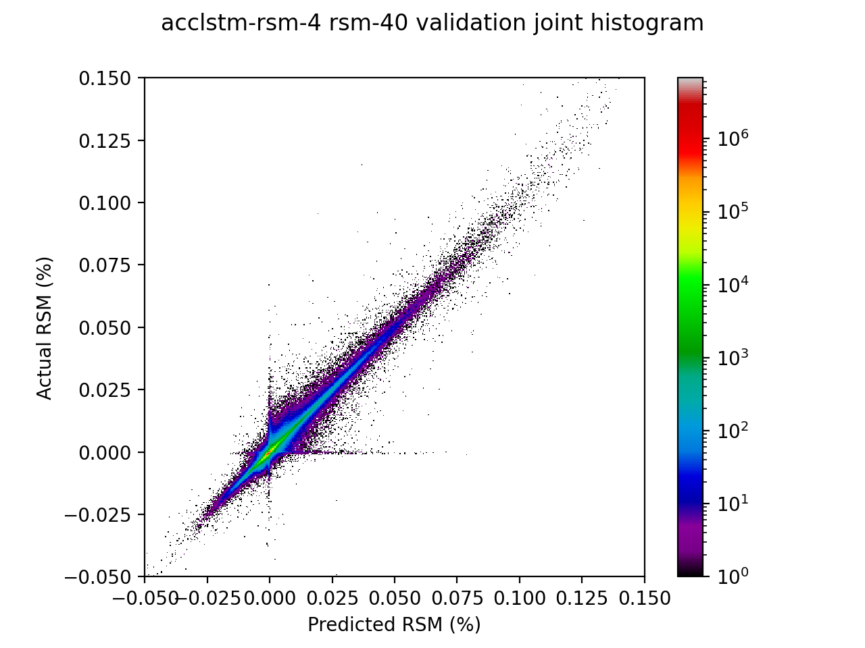
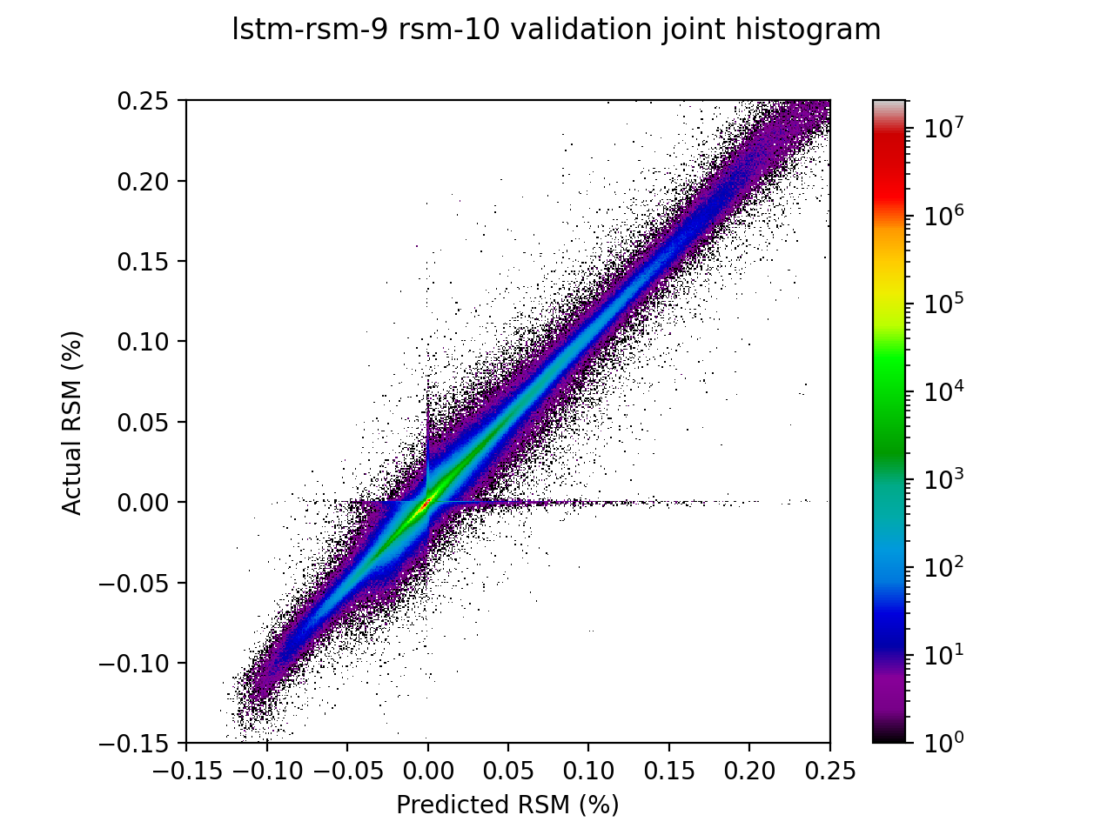
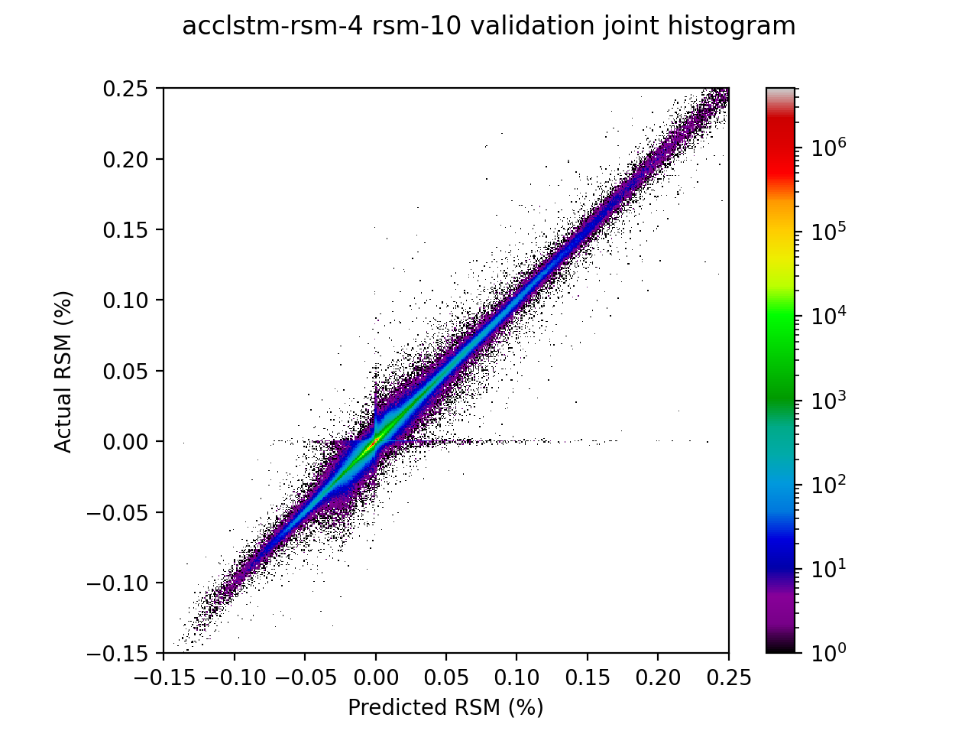
Bulk Evaluation: Validation Histograms
These are basic validation curves for hourly increment change in the form of a heatmap, (log axis) showing the divergence of predictions from the actual data in each value bin.
True/predicted joint histograms for relative soil moisture
The ‘tails’ contouring the zero bin of both axes indicate that sometimes precipitation events are fabricated, missed, or lagged. This is typically in the first 3 output timesteps.
Overall, there is no strong bias toward over or under-predicting hourly change in soil moisture.
Visually, the AccLSTM has the “tightest” validation curve.
FNN
LSTM
LSTM-RSM
Missed precipitation events or anomalous spikes in moisture content can be very detrimental to performance
AccLSTM-RSM

Slide 10
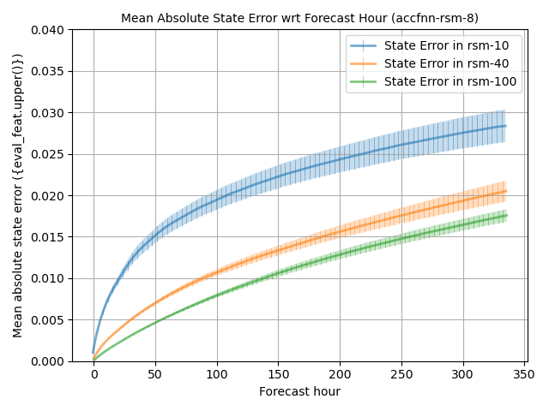
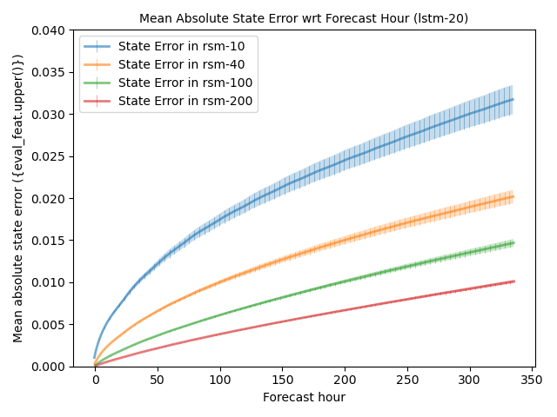
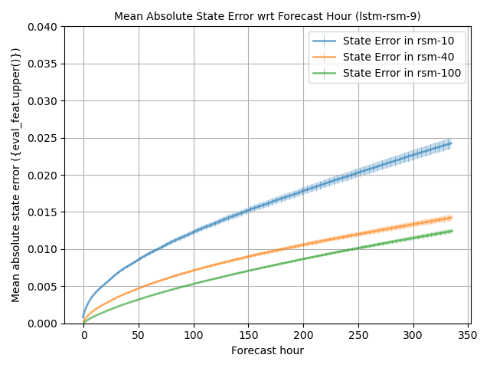
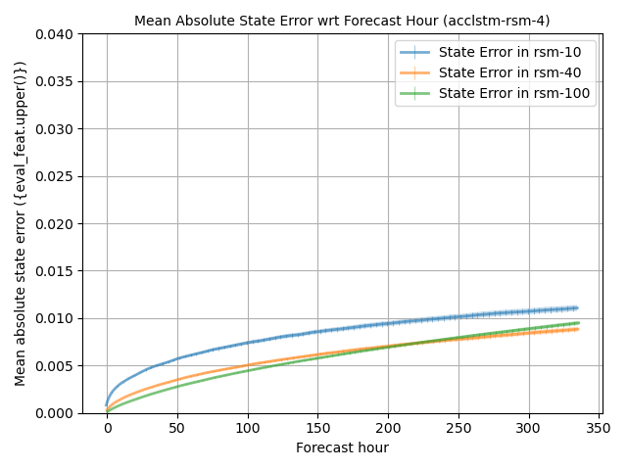
Bulk Evaluation: Horizon error
Horizon error rates indicate how prediction accuracy changes with distance from the initial forecast hour.
Models universally have their highest error rates at hour 0, which suggests that the spin-up window encoder needs to improve.
AccLSTM is the best performer by a wide margin, with all layers’ MAE under 1.2% (RSM) throughout the output sequence.
Initial timesteps are the worst-performing, so encoder needs to improve.
FNN
LSTM
LSTM-RSM
AccLSTM-RSM

Slide 11
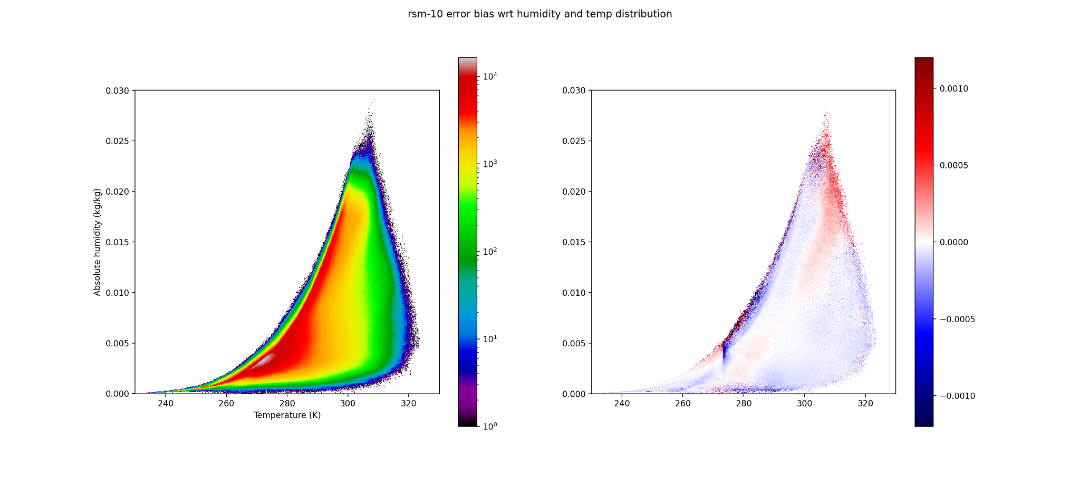
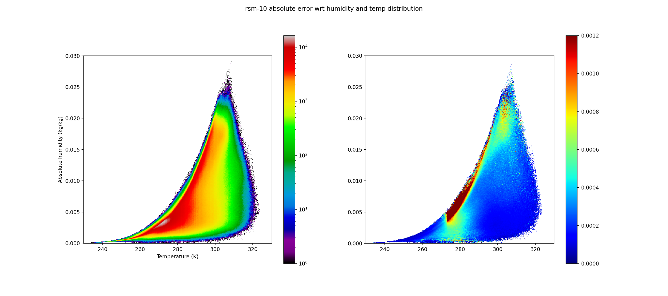
Bulk Evaluation: Error wrt Humidity/Temp
RSM-10 error wrt humidity and temp distribution
AccLSTM
Plotting error magnitudes and biases’ correspondence to input parameter distributions can lend interpretability.
Highest error rates near saturation above freezing. At saturation, increment change often overestimated, but underestimated nearby.
Local error maxima near the freezing point, and very hot and humid air.
Unsaturated air generally slightly negatively biased, except for a stripe at ~60% humidity.
Mean error bias on distribution
Humidity
Temperature
Just above freezing, increment underestimated; overestimated just below freezing.
Mean error magnitude on distribution
Strong error maximum near cool air saturation
Humidity
Temperature

Slide 12
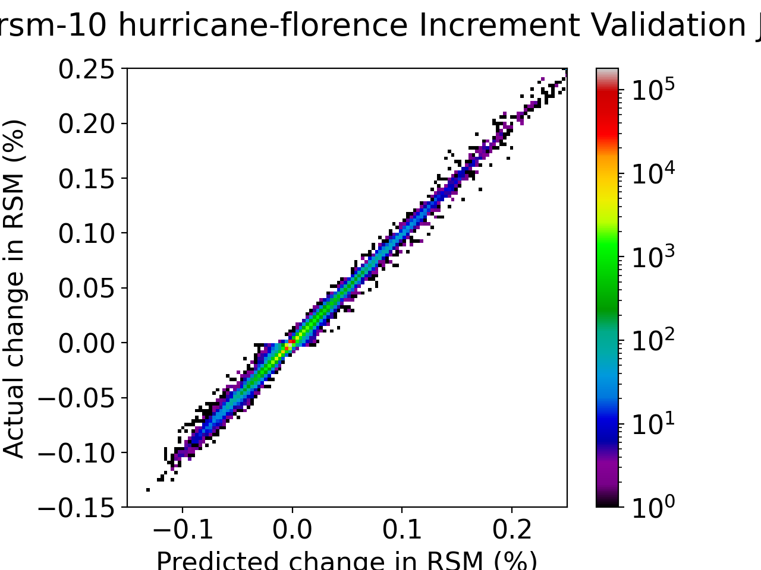
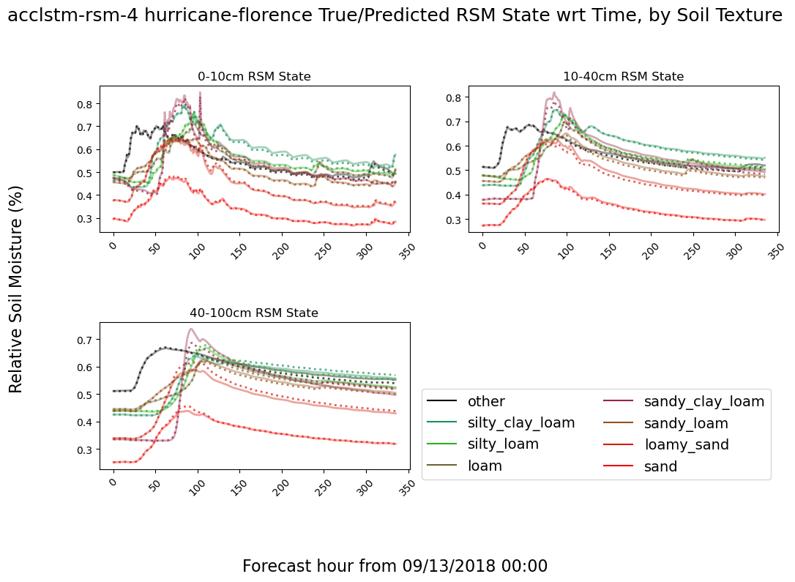
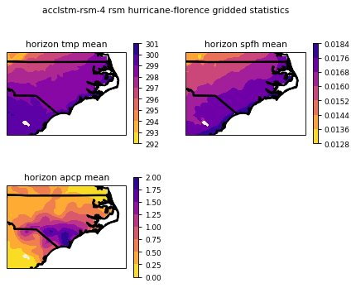
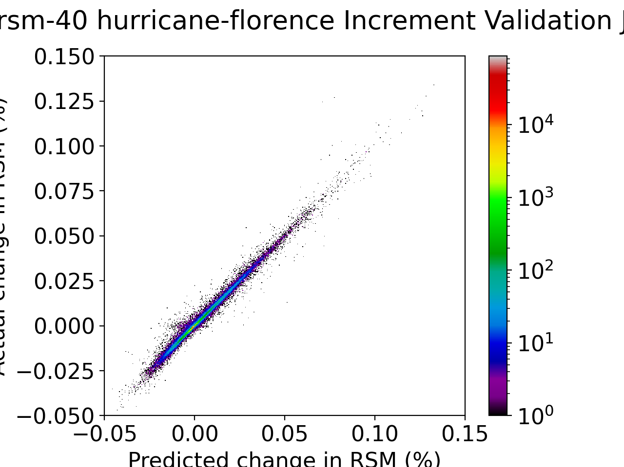
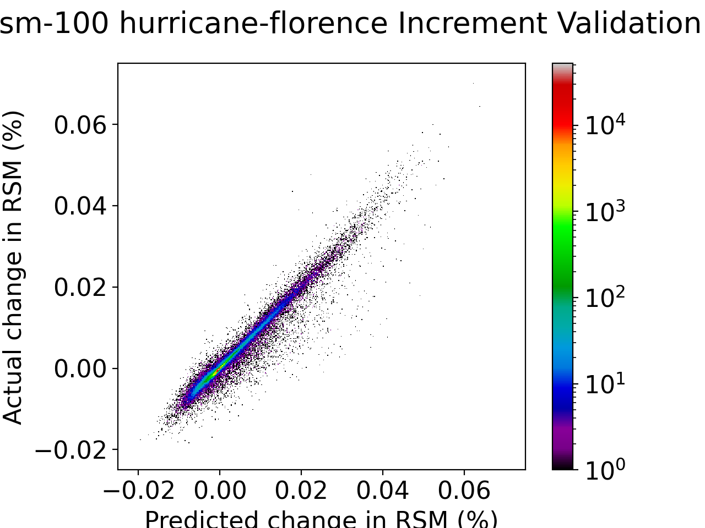
Case Study: Hurricane Florence
Florence made landfall in North Carolina on September 14, 2018, and caused severe inland flooding by lingering over the state.
Relatively dry soils experienced considerable surface runoff. Water that infiltrated the soil quickly percolated down to lower layers.

Slide 13
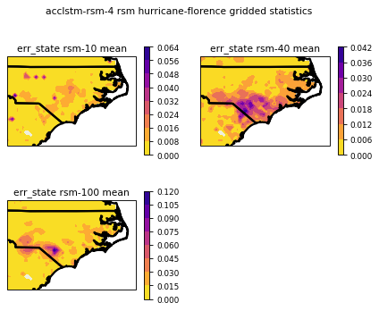
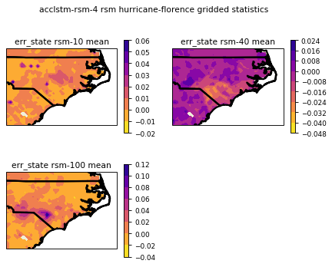
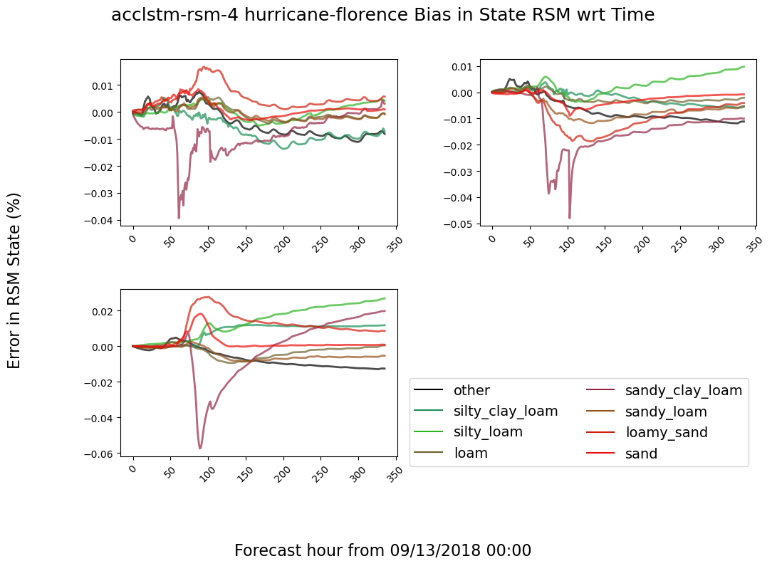
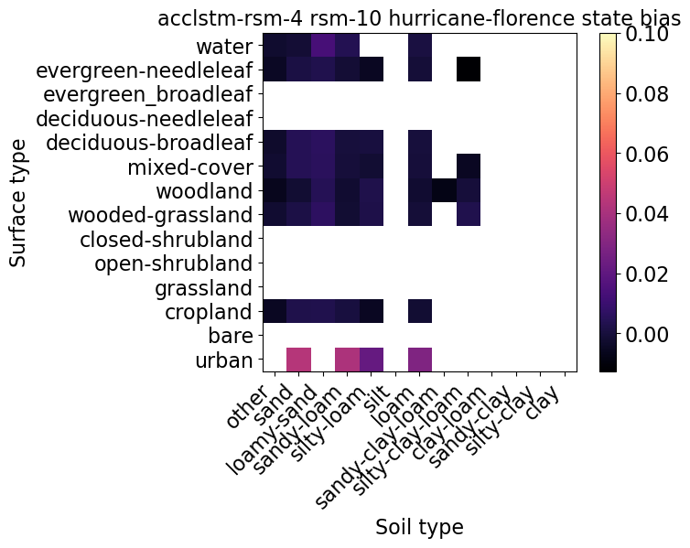
Case Study: Hurricane Florence
Mean Absolute Error in Saturation State (RSM)
Error Bias in Saturation State (RSM)
In this scenario, the largest error corresponds to:
Urban surface types
Sandy soil draining too quickly from L2 to L3
Loamy sand pixels just after landfall underestimate initial infiltration rate.
Error in RSM state is generally constrained within 2.5%, but briefly peaks at about 4-6% for loamy sand textures.
Charolette,
other cities
Sand and loamy sand pixlels too dry in L2, too wet in L3 after landfall
Fayetteville
Bias in Saturation State wrt Time (RSM)
Urban pixels universally have highest error rates

Slide 14
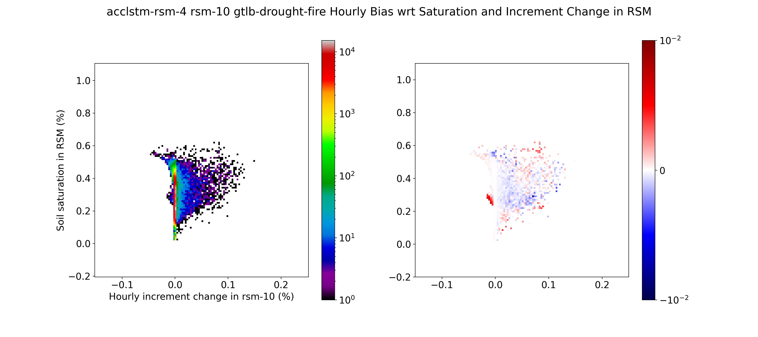
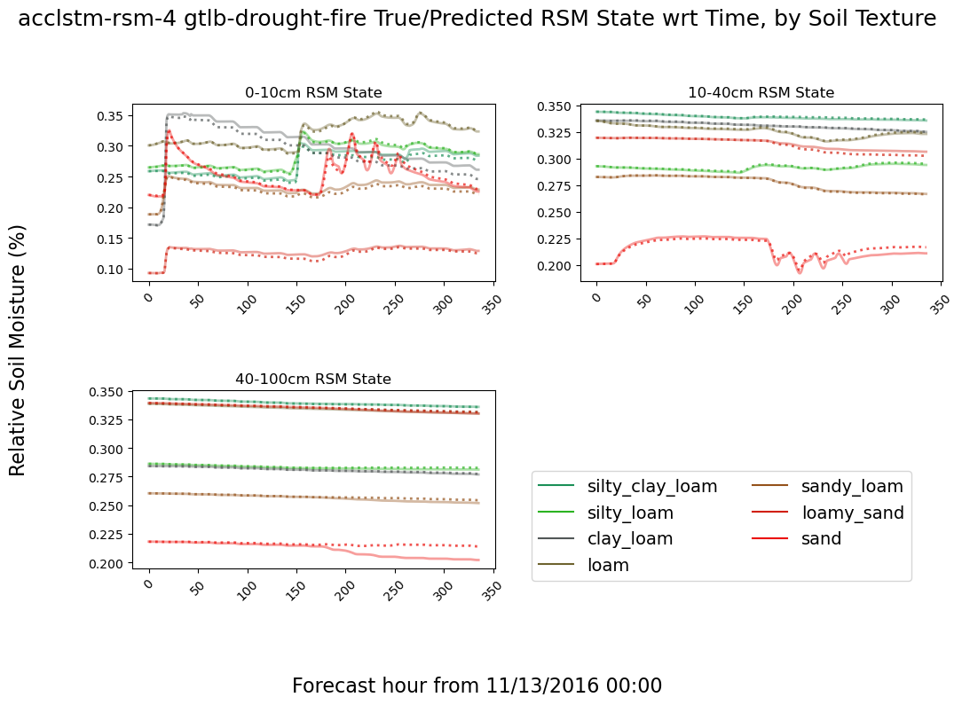
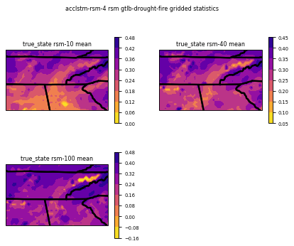
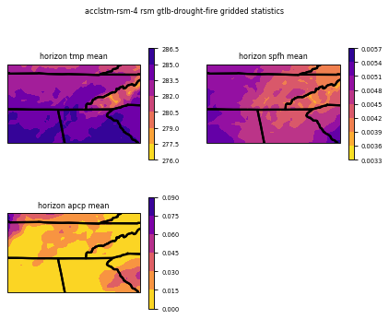
Case Study: Gatlinburg Drought (+ Fire)
In November of 2016, the mountains of East Tennessee were experiencing a serious drought, exacerbating a devastating forest fire until a series of rain events brought some relief.
In general, model error in this case stemmed from slow percolation rates, especially in sandy soil.
Pixels with low RSM are draining too slowly
Sandy soil doesn’t drain enough in lower layers
Extremely dry soil in mountains of East Tennessee

Slide 15
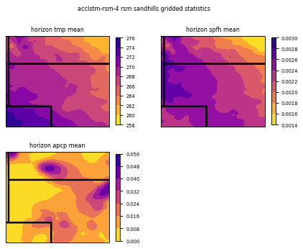
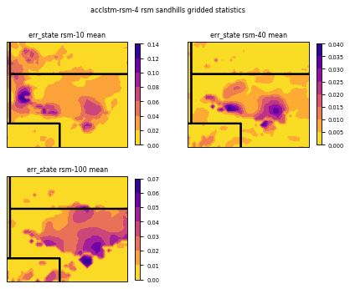
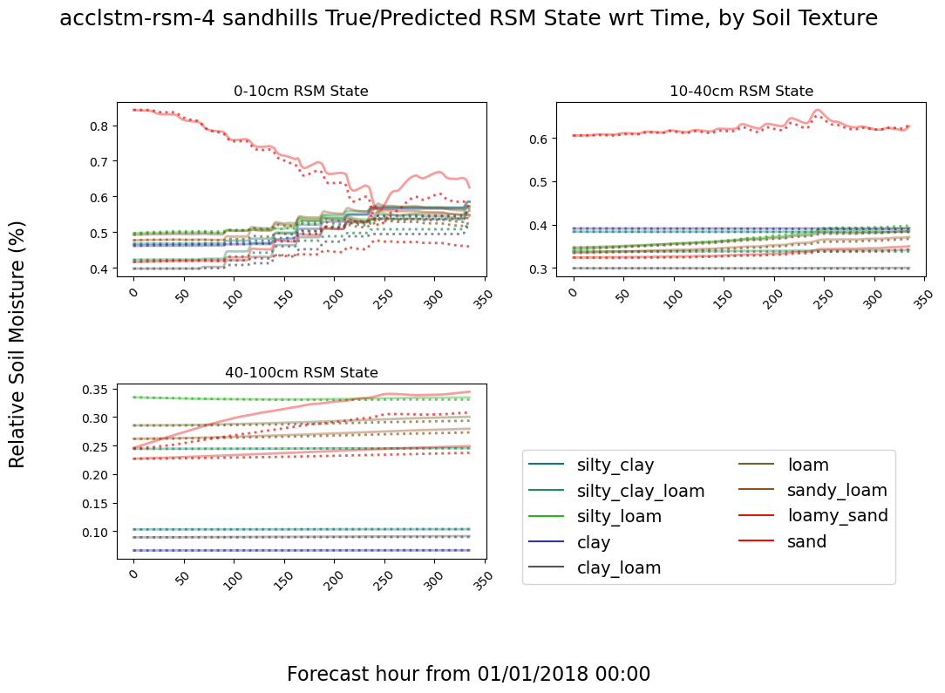
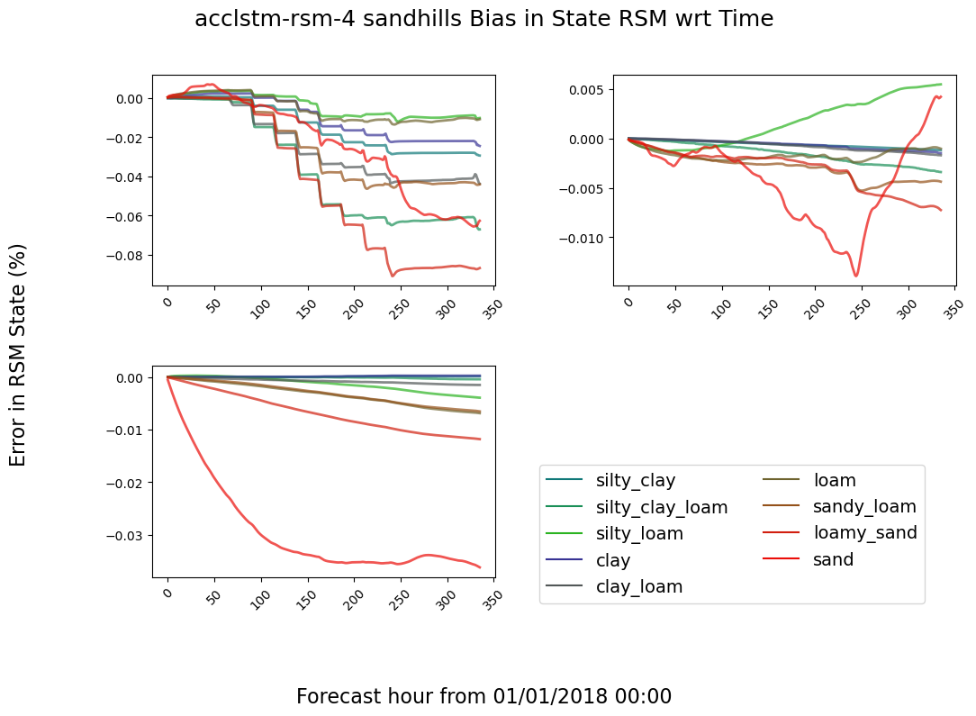
Case Study: Nebraska Sandhills
Many models struggle with the sandhills region of Western Nebraska, likely because of high saturation and since forcings in this region are distributed differently than most sandy places (Florida, SoCal, Texas).
In this case, lower soil layers are frozen, and the upper layers experience diurnal freezing and thawing.
Highest error rates at every layer are associated with the sandy region
The model over-estimates the accumulation of water in lower level sandy frozen soil
Diurnal freeze/thaw process

Slide 16

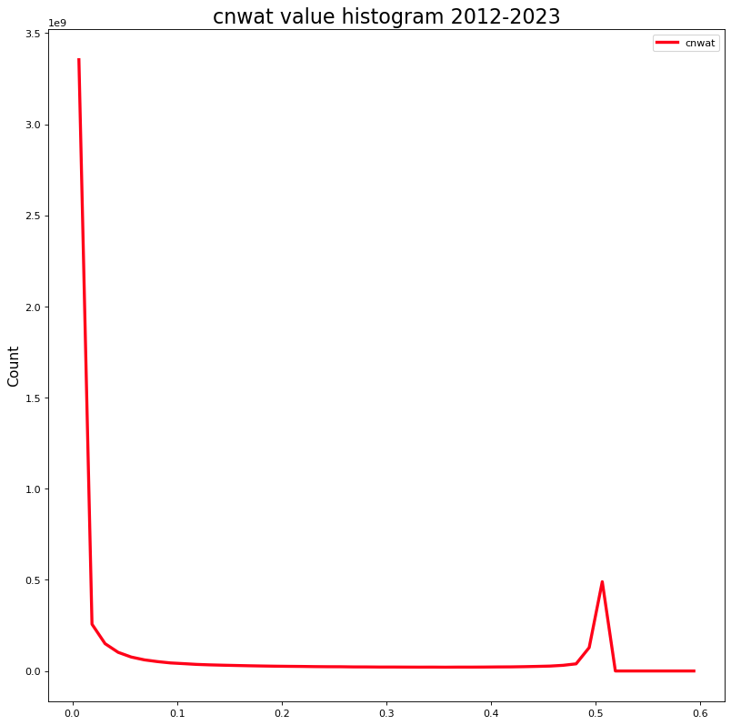
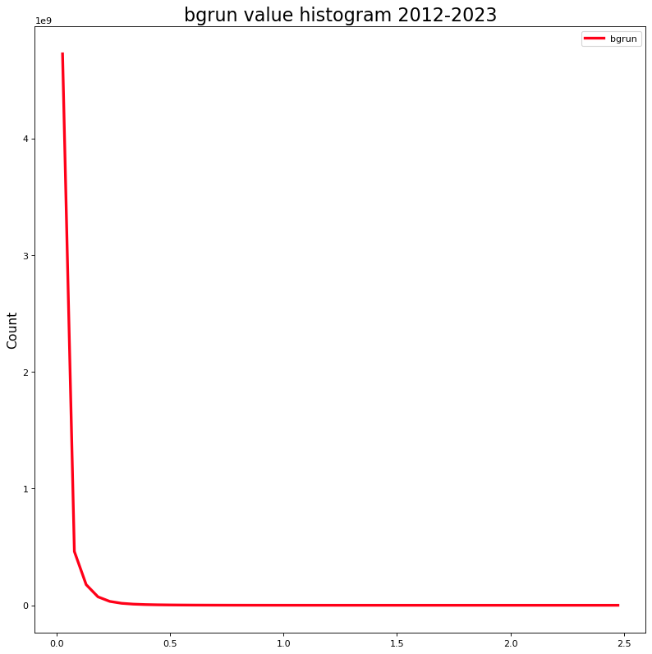
Future Directions / Questions?
Applying this emulation framework to NLDAS-3 (in progress) as a collaborator on the NASA WaterInsight project.
Stratified sampling techniques and further loss function manipulations could improve edge case performance, ex. by assigning sample importance by forcing histogram position.
Process-aware architectures could aid explainability and physical integrity of models, ie coupled neural networks specializing for snow, canopy dynamics, evapotranspiration, subsurface soil dynamics, etc.
Lightweight models could be deployed in an operational context to make quick estimates of soil response given manually manipulated forcings.
Highly skewed distributions for canopy water content and background runoff. Several processes are important, but normally close to zero.

Slide 18
Neural Net Training Methodology
There are no generally reliable “rules of thumb” for model development. Model shape, loss environment, and hyperparameters must be adjusted through experimentation.
I typically start by training a couple models with a reasonable hyperparameter configuration and size around 50,000 learnable parameters to get a performance baseline for reference.
Then, I iteratively adjust the independent variables and train models until validation loss stagnates or begins increasing, watching learning curves for signs of local minima or learning rates too high.

Slide 19



Evaluation Example: Error wrt Saturation/change
RSM-10 error wrt humidity and temp distribution
AccLSTM
Error rates and biases can also be related to the true saturation magnitude and change in saturation at each depth level.
The highest error rates were associated with significant precipitation and dry-down events near saturation, probably due to the influence of infiltration dynamics.
The influence of the strongest rainfall events on change in layer 1 RSM is a mixture of under and over-estimations.
Error bias on distribution
Under-estimated infiltration near saturation
Saturation (RSM-10)
Change in RSM-10 wrt time
Dry-down rate tends to be under-estimated in mid/low saturation range
Error magnitude on distribution
Saturation (RSM-10)
Typical dry-down curves are associated with lower error rates
Change in RSM-10 wrt time

Slide 20






Evaluation Example: Sample Cases
Selecting a set of pixels within a small region during a particular meteorological event is helpful for getting a basic sense of how models are behaving in practice.
INCREMENT ERROR
Interpolates on a finer scale than the model’s numerical precision
Error often arises from underestimating magnitude of change in state
Sometimes exceeds saturation point
STATE ERROR
Learns unique dynamics of different soil textures encoded by static data

Slide 21





Evaluation Example: Infiltration Validation
Infiltration rates may be calculated as the ratio of hourly change in soil moisture area density (kg m⁻²) to hourly rainfall (kg m⁻²).
Soils with low water content generally correspond to lower infiltration rate accuracy.
These diagrams also corroborate the problem of missed, fabricated, or lagged precipitation events.
FNN
LSTM
LSTM-RSM
AccLSTM-RSM

Slide 22



Supporting Open Science
I am a strong believer in the principle of Open Science.
My code base was carefully written to be highly generalized for a variety of time series prediction tasks with larger-than-memory datasets.
The software (more than 10,000 lines of Python) is published on GitHub under an MIT license, and includes some external and extensive internal documentation.
https://github.com/Mitchell-D/testbed
Excerpt of external documentation

Slide 23

Lessons So Far
Models predicting soil state directly are noisy and quickly converge; predicting increment change in soil state encourages stability and continuity.
Transient values like snow are best learned by ignoring negative predictions in loss function when state is zero.
Weighting the loss function heavily toward samples with larger increment change magnitude mitigates low-magnitude bias.
Performance is considerably improved by normalizing pixels between their soil texture’s wilting and saturation points.
Cyclical learning rate schedules speed up training and help evade local minima.
2012-2018 soil state histograms by texture
Left: area density. Right: relative soil moisture

Slide 24




Lessons: State vs Increment
Models predicting soil state directly are noisy and quickly converge; predicting increment change in soil state encourages stability and continuity.
Samples to the right show 12 hour time series predictions from a model trained to output the soil state rather than the change in state between timesteps.
Despite the noisy results, the overall distribution of output values closely matched the true values.
The highest error rates were associated with areas having soil types most commonly found in other regions with different weather.
This led me to recognize that the models capture the most probable soil moisture magnitude given the forcings & static parameters.
Such models aren’t strongly incentivized to maintain continuity between consecutive timesteps.

Slide 25





Lessons: Snow
Since snow (and other processes like runoff and canopy interception) are rare in terms of the full training set, there is a local minimum in loss if models always predict zero state / change in state.
One trick to solve this problem is to recognize that when there is no snow, we can safely ignore predictions of a negative change in snow.
As such, modify the loss function to ignore samples if the snow state is zero and the model output is negative.
Model predicts zero change in state
Without modification, snow melt and snow fall events are ignored by the model

